Slide 1
Derek Ross
Final Project Proposal
Midi-Keyboard

Slide 2
Midi-Keyboard
A Midi-Keyboard is a keyboard that you can hook up to your computer and use it with different music creation software to produce all sorts of cool results! The idea in the end is to have an LED keyboard have its keys mapped to different sound notes and eventually light up with the proper key to play for a song!

Slide 3
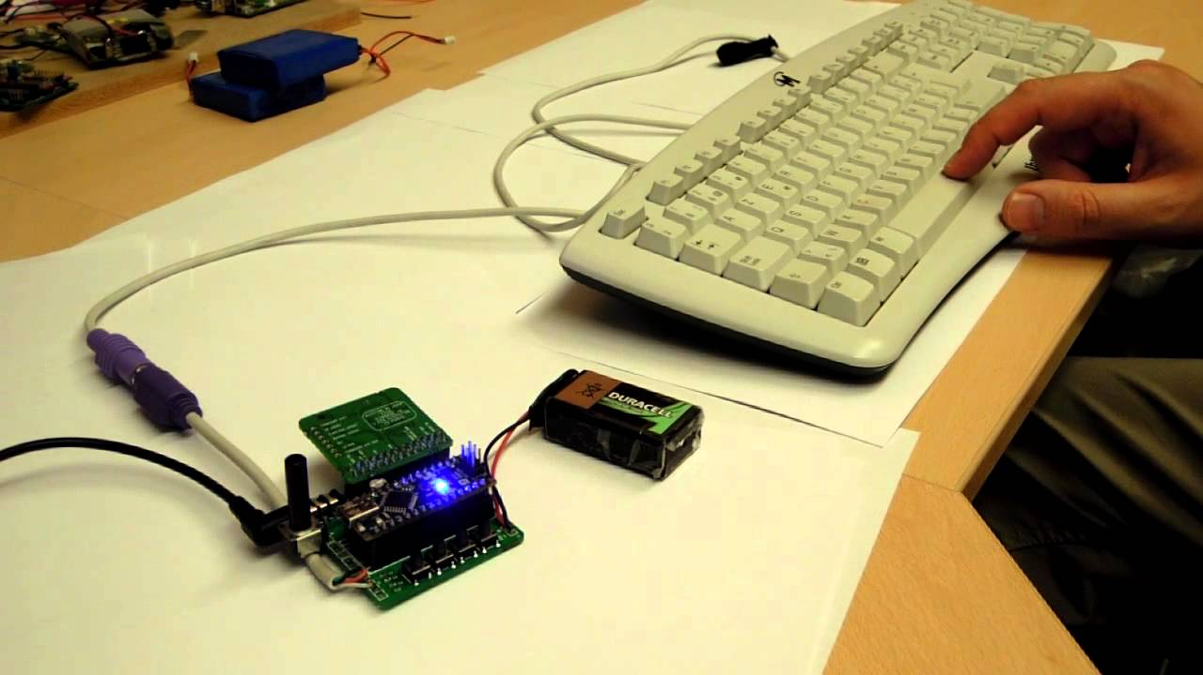


Components
In order to do this project theres a few steps that need to be completed to combine for the end result.
Hardware The Arduino must be built and set up to interact with our LED Keyboard.
Software We need to configure the software to take a library from racket and send it ot the arduino which sends it to the keyboard.
Coding Lastly we need to map keys to notes in an Object Oriented fashion in Racket.

Slide 4
External Things Needed:
1. Arduino Board
2. Serial-to-Midi Conversion Software
3. LED Keyboard

Slide 5
Internal Components
Libraries and Accessories:
. Port Audio (Audio Engine)
. Midi (Parser for MIDI Files)
. Rsound (Plugin Library)
. Rtmidi (Creation of a virtual port)
. Midiworld (Free Midi Files for testing)
. Piano Notes (Folder with notes)

Slide 6
Why we Chose this?
This was something Patrick was very passionate about. He is too sick unfortunately to explain his story, but from what he told me he has a deep passion for Computers and Music. He has always wanted to be able to create something with the computer to teach someone how to play music. The High Level goal was to use our knowledge to teach someone how to play the piano on a keyboard.

Slide 7
What can OPL Bring to this Project?
Approaches:
Data Abstraction - The goal would to create some objects that represent the keyboard and the notes. From there each key needs to be assigned and we can do that using object orientation and assignment.
Recursion - I believe we could incorporate this by making a function that recursively assigns the notes to keys at the start of the program provided we order the keys / notes the way we want. If this is too far out then I still think we could atleast make a light show from recursion.
Object-Orientation- Kind of building back onto the data abstraction the goal is to create objects for the keyboard and notes. In order to assign them we need objects and in order to be abstract we need objects to assign this too.
Functional Approaches- I would like to see possibly a few functions that can map the keys once we get set up and possibly may even be able to play a song using like a recursive call going down a list of planned notes!
State-Modification Approaches - As of right now the objects will be changing often depending on what note they encapsulate. So long answer is yes, short answer is there's a good possibility.
Expression Evaluator - As of right now I don't see this or map/filter/reduce really fitting into the project. I don't want to bite off more then we can chew yet but I can see us making something to evaluate notes for a template song that someone can learn piano by following - which is what Patricks passion / goal was in the first place.

Slide 8
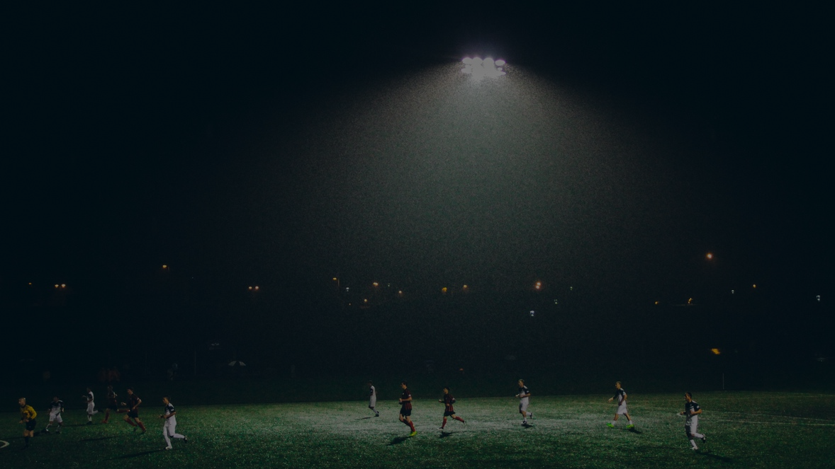
Future Goals and Expectations
Goal: The goal is to have a working Demo for the students and professor to try come final
Evaluation of the project. At the current state of giving this presentation my goal is to
Explain our enthusiasm for the project and bring life to the details that we will be
Incorporating from our OPL class.
Low Level View: A Mapping of Notes to each key on the keyboard
Mid Level View: A Mapping of Notes to each key on the keyboard with the ability to play a song recursively on its own through a function call as well.
High Level View: A Mapping of Notes to each key on the keyboard with the ability to recurisvely light up each key individually that is the next note for the song teaching the user how to play the song.

Slide 9
Final Notes:
I love Music and I hope I can atleast bring something interesting with innovation of lessons taught in class to my fellow peers and mentors.
If there are any Questions at this time please let me know and I would be happy to answer them to the best of my ability.

Slide 10
Citation
All work done in these Slides and in the Final Presentation Proposal has been done and completed by:
Name: Derek Ross
Email: Derek_Ross@Student.uml.edu
Github: DerekR0123

